Slide 1
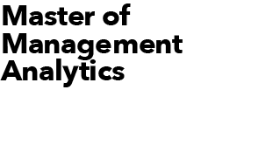
DATATHON 2022
Team Violet
June 15, 2022 Prepared by Sameer Pasha, Sky Niu, Sunny Chen, David Hamilton

Slide 2
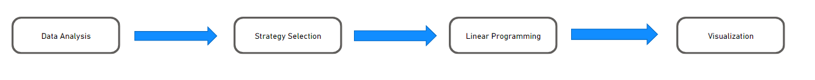
Objective
Selecting five power play specialists and four penalty kill specialists to help Toronto Six assemble a team for their new NWHL season.
Power Play Specialists:
The main objective of the power play players are to score goals and pass precisely.
We are aiming to build a team that is not only good at the above skills but also display a versatile performance and implement a strong strategy.
Penalty Kill Specialists:
The main objective of penalty kill players is to prevent opponent from scoring goals.
The key skills of penalty killer are takeaways, precise passing and puck recovery.

Slide 3
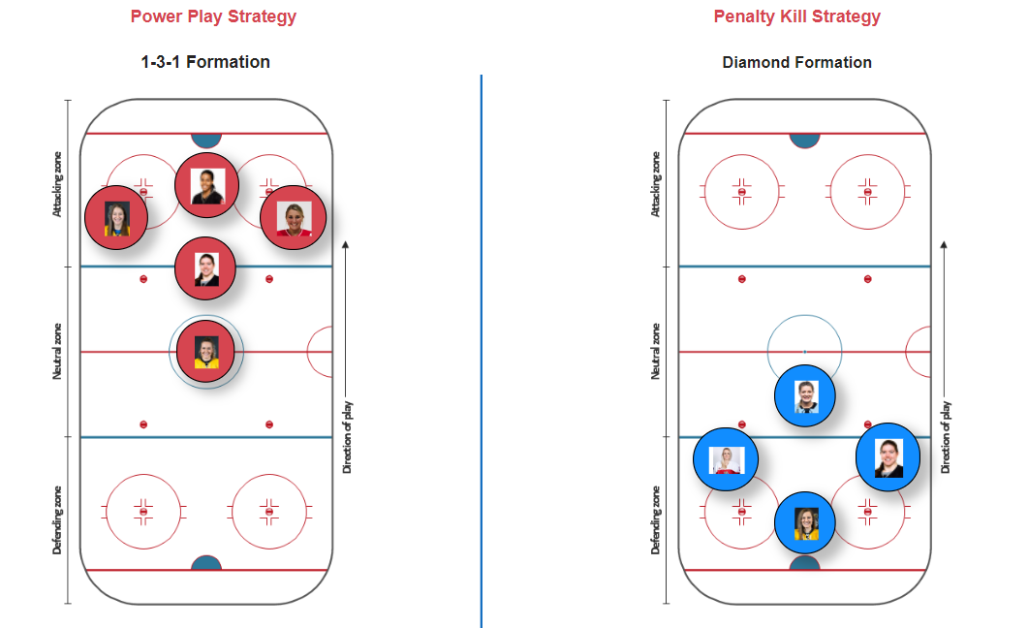
Strategies
Power Play:
The strategy that is selected for power play is a 1-3-1 player formation.
The 1-3-1 can spread out players inside the zone, keep a player in front of the net at all times, and position shooters in crucial positions to shoot.
Penalty kill:
Diamond penalty kill formation is the one going to be implemented in this experiment.
The player at the apex is a takeaway expert and the right and left wing are players who are defenders and passers.
The player at the back is a puck recovery specialist who is also good at the above skills, therefore the team will gain possession quickly after an unsuccessful shot attempt is taken.
Note: Please feel free to access below our Power BI dashboard to interact with player performances and strategies.

Slide 4
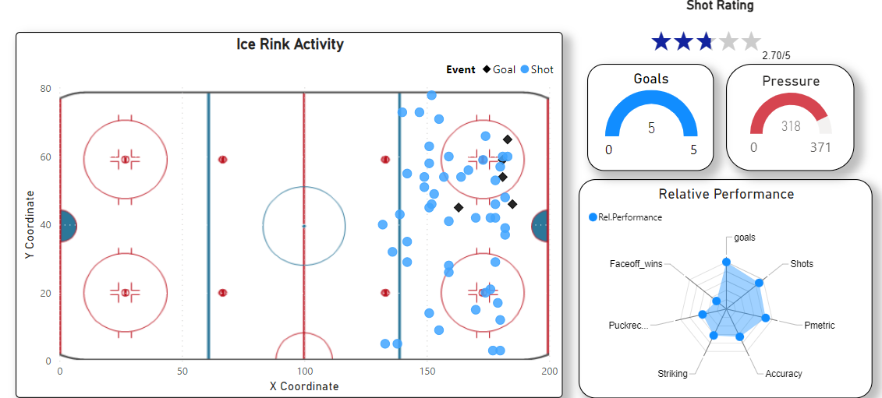
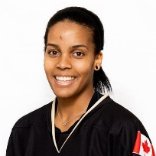
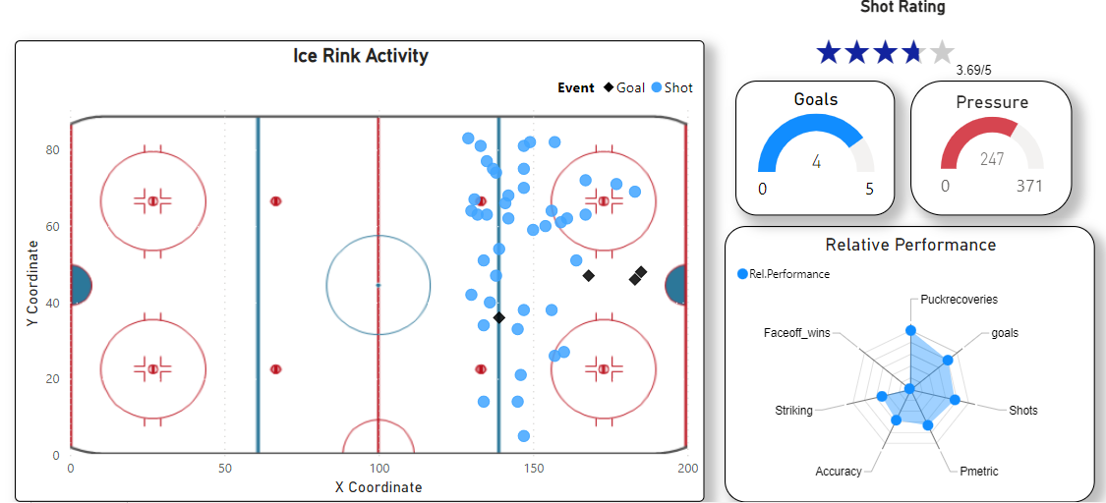
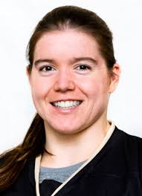
Power Play Specialists
Mikyla Grant-Mentis
Subtitle
She is the highest goal scorer with 5 goals in
the last season.
She has the highest number of shots on net.
She is an offensive player, who can act as a
center forward in the 1-3-1 formation.
Her shots were majorly in the center of the field and
she has the third highest pressure metric.
Her pass accuracy with Taylor woods is 87.5%.
Taylor Woods
She recovered the second highest number of loose pucks.
She is a shooting expert who scored 4 goals in
the last season.
She has the third highest number of shots on net.
Most of her shots were around the blue line, and she has the sixth highest pressure metric.
She is a good shooter with advanced puck recovery skills, who can be a bumper in the 1-3-1 formation.

Slide 5
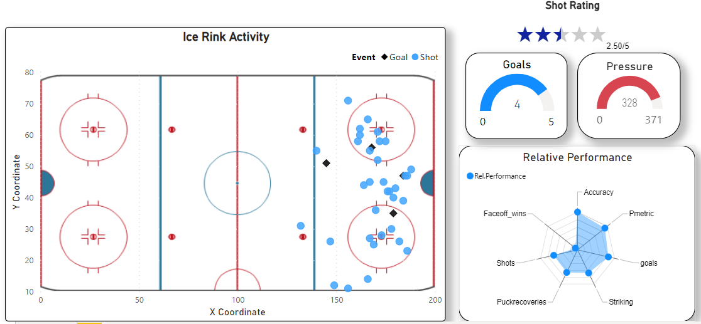
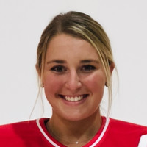
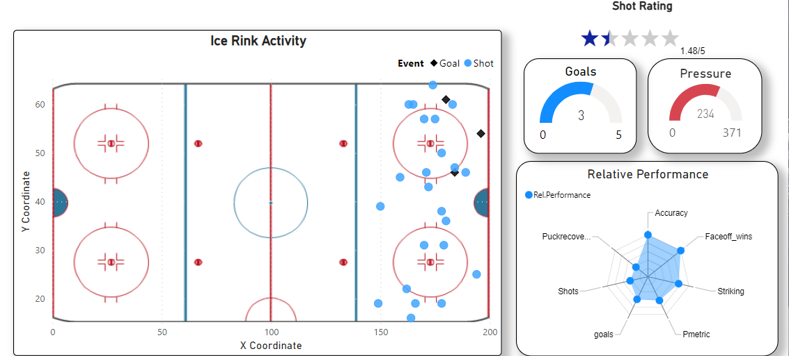
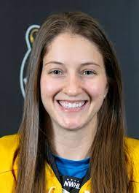
Power Play Specialists
Samantha Davis
She is a good shooter who scored 4 goals in the
last season.
Her shots were majorly in the center of the field, and
she has the second highest pressure metric.
Her pass accuracy in the last season is 72.5%.
She has expertise in precise passing and striking pucks, who can act as a right flank in the 1-3-1 formation.
Jillian Dempsey
She has the highest number of total faceoff wins in
the last season.
Her pass accuracy in the last season is 71.6%.
Her shots spread out in the field, and she has the
eighth highest pressure metric.
She has expertise in precise passing and striking pucks,
who can act as a left flank in the 1-3-1 formation.

Slide 6
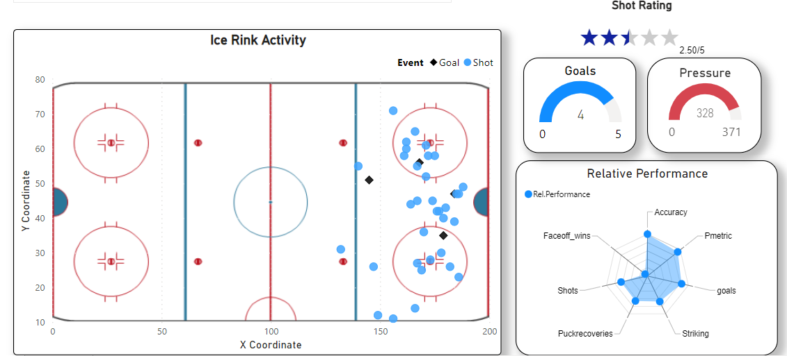
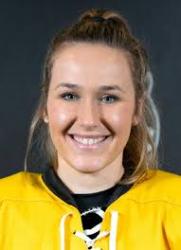
Power Play Specialists
Mckenna Brand
Her shots were majorly in the center of the field, and
she has the highest pressure metric.
She is a good shooter who scored 3 goals in the
last season.
Her pass accuracy in the last season is 69.9%.
She has expertise in precise passing and striking pucks,
who can act as a quarterback in the 1-3-1 formation.
Shot rating of a player is determined by the nature of the shots that the player has played. If a player has more ‘one timer’ and ‘traffic shots’
then the player has more shot rating.
A Radar chart is used to visualize the relative performance of a player. Relative performance of a player in a particular category is determined by
the players performance compared to the highest performance in that particular category taken as a percentile.

Slide 7
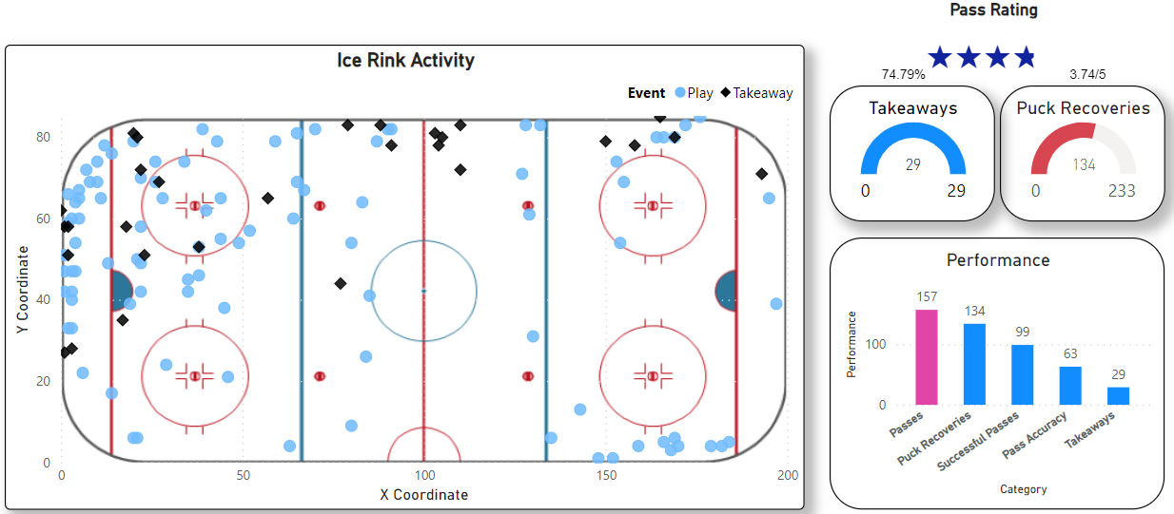


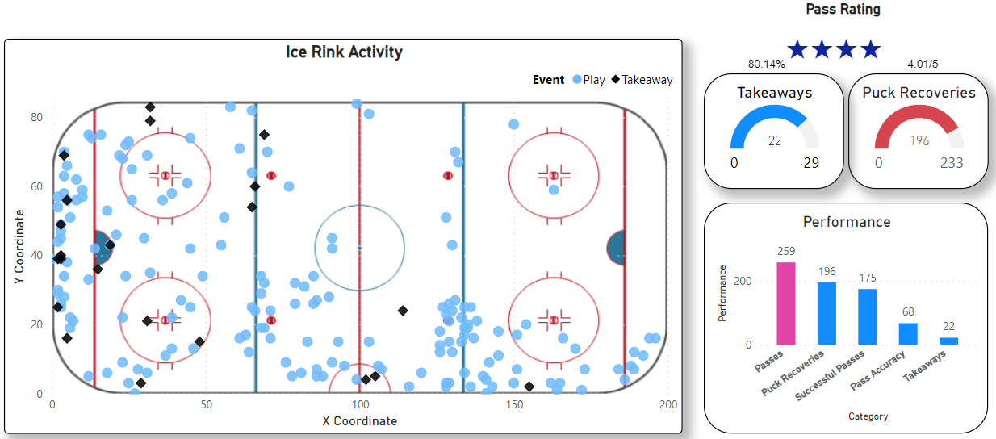


Penalty Kill Specialists
Dominique Kremer
Dominque is a takeaway specialist and the league leader in total takeaways.
She also excels at puck recovery, furthering her team’s control of the puck to run out the clock.
Her pass rating in the dataset is 74.79%.
She plays at the top of the diamond to maximize her abilities.
Mallory Souliotis
Mallory is a puck recovery specialist who consistently beats the other team to the puck.
Her pass rating in the dataset is 80.14%.
She also excels at takeaways, with a focus the defensive zone and behind the net.
She plays at the bottom of the diamond as the last line of defence before the goalie.

Slide 8
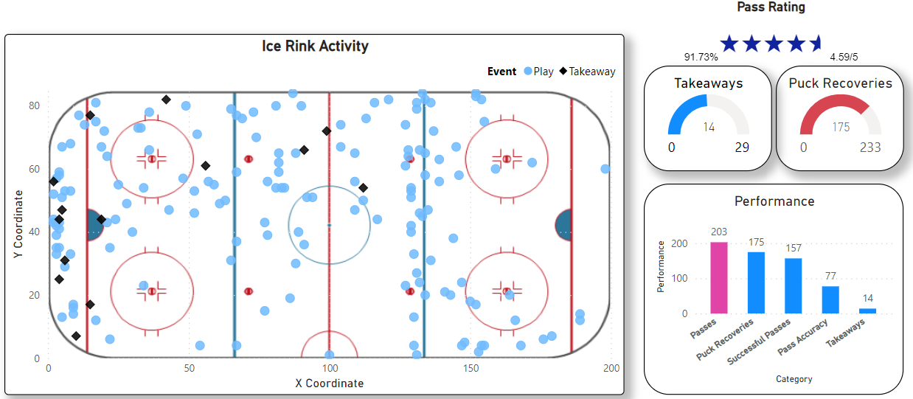


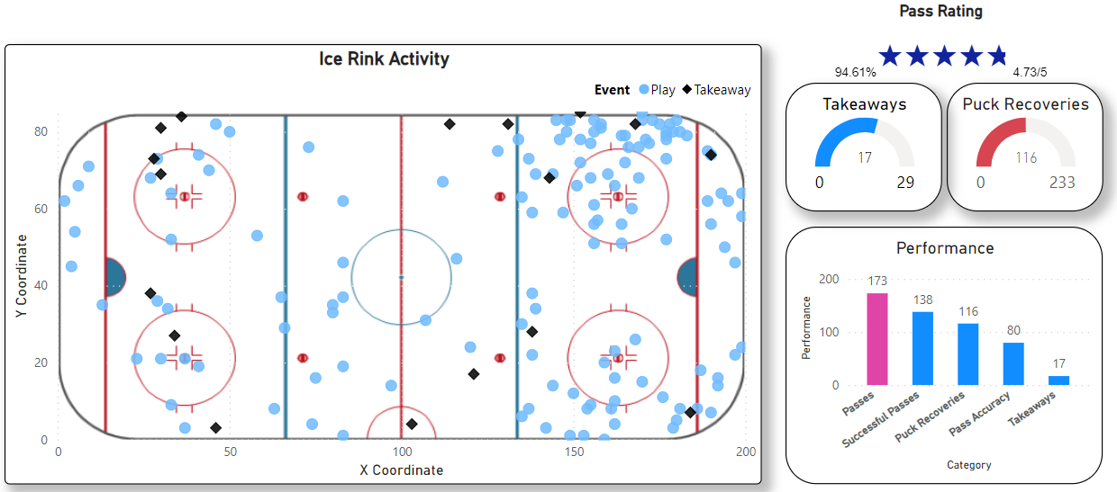
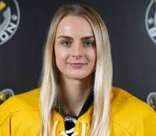

Penalty Kill Specialists
Taylor Woods
Taylor is a passing specialist who racks up big passing numbers.
Her pass rating of 91.73% is 4th highest in the dataset, with more passes than any player ahead of her.
She also excels at puck recovery, ranking 3rd in the dataset.
She plays on the right side of the diamond, using her precision passing to keep control of the puck.
Tereza Vanisova
Tereza is the other passing specialist with the second highest pass rating in the league.
Her pass rating in the dataset is 94.61%.
She also has good numbers for takeaways and puck recoveries to help her team control the puck.
She plays on the left side of the diamond and uses her skills to run out the clock until the penalty ends.

Slide 9
Appendix
Linear Programming
The Selection of the team is an optimization problem subject to constraints. It can be treated as a Linear Programming problem having
Decision variables, Objective Function and Constraints. Excel Solver is used to implement and solve this problem.
Decision Variables:
Each of the selected players among the pool are considered as decision variables.
The decision variables are of binary data type. They take values 0 (not selected) or 1 (selected).The notation of decision variables is x1,x2,x3…….
Power Play:
Objective Function
To maximize goals (g1*x1+g2*x2…………..g20*x20). The objective function is designed in such a way that the top scorers get more weightage.
Players who have at least two goals are selected.
Constraints
Five players are needed in the team among the pool(X1+X2………..+X20 = 5)
At least three players must be excellent goal scorers (X1+X2……….+X20 >=3)
One player from top 2 puck recovery specialists (X4+X7 = 1)
One player from top 2 pressure specialists (X3+X8=1)

Slide 10
Appendix
Penalty Kill:
Objective Function:
To maximize Takeaways (t1*x1+t2*x2………..t54*x54). Top 50 %ile of players sorted by takeaways are taken for selection.
The objective function is designed in such a way that players with more takeaways get more advantage.
Constraints:
Four players are needed in the team among the pool (X1+X2……….+X54 =4)
At least two takeaway specialists among top 25% (X1+X2…….+X30 >= 2)
Two excellent passers among top 4 passers (X23+X37+X38+X45 = 2)
One puck recovery specialist among top 2 puck recovery specialists (X8+X24 =1)
The solving method used for solving this problem is the Simplex Linear Programming as all the constraints and the objective function are linear in nature.
Tools used in the project
R (Data Analysis).
Excel Solver (Linear Programming).
Power BI ( Data visualization for dashboard).
Note: Please feel free to access below our Power BI dashboard to interact with player performances and strategies.

Slide 11
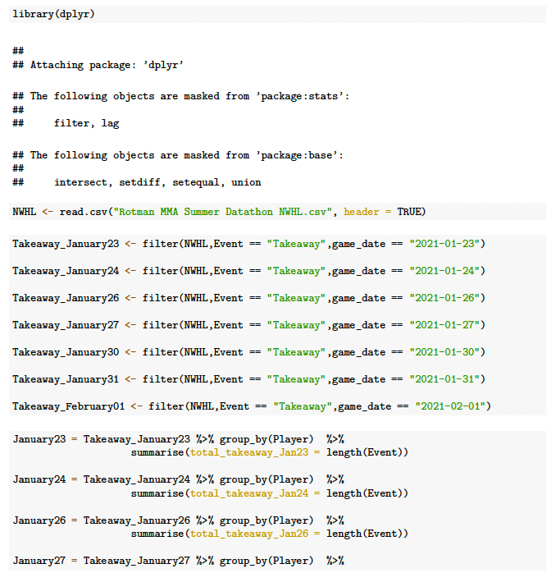
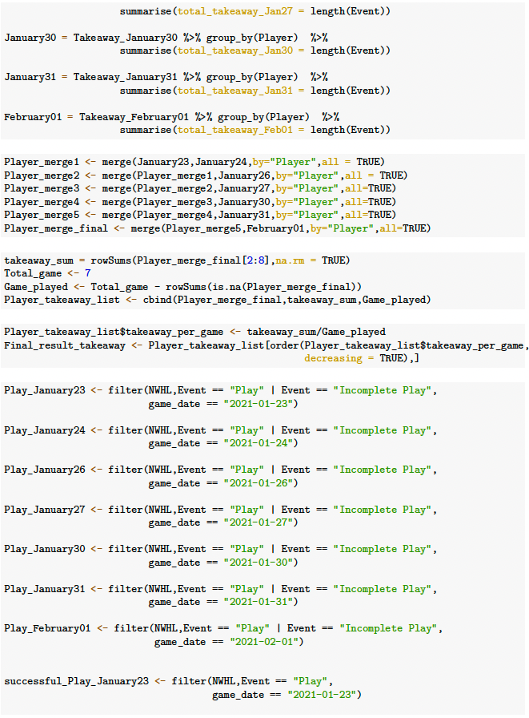
Appendix
Penalty kill R code:

Slide 12
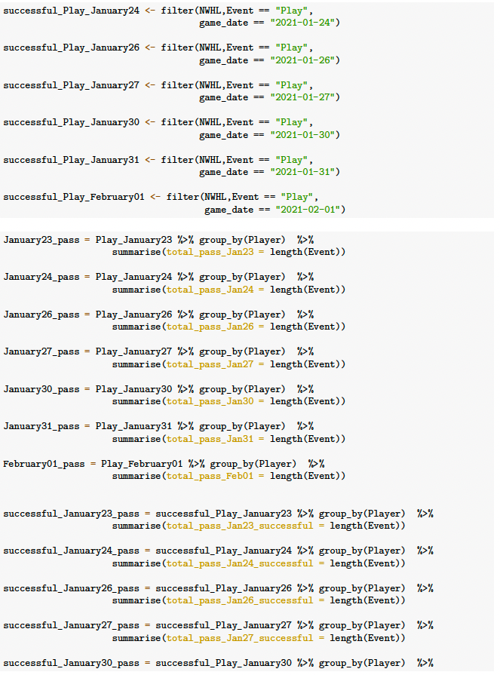
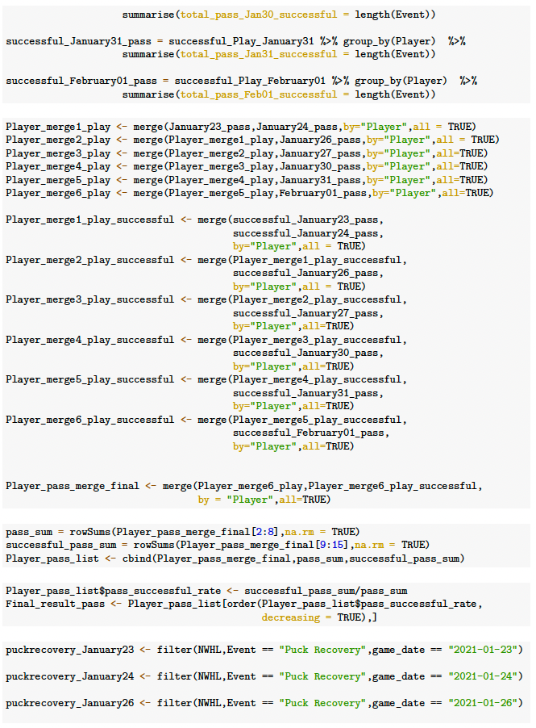

Slide 13
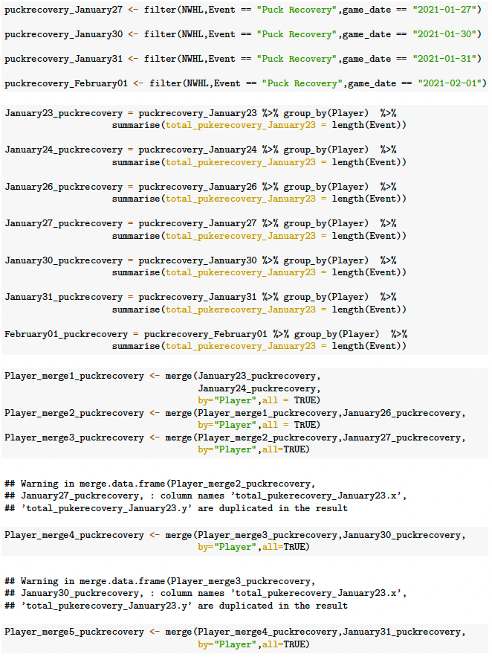
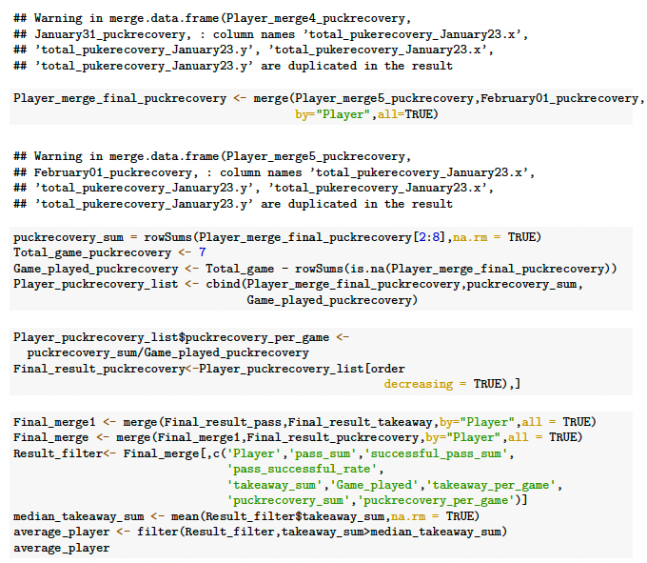

Slide 14
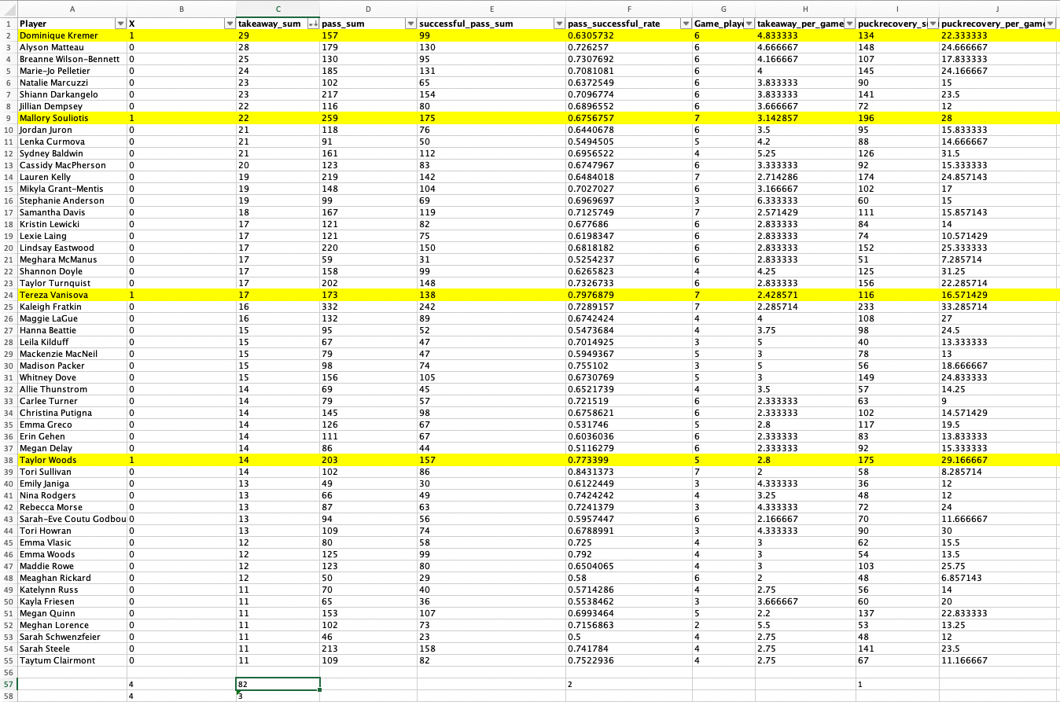
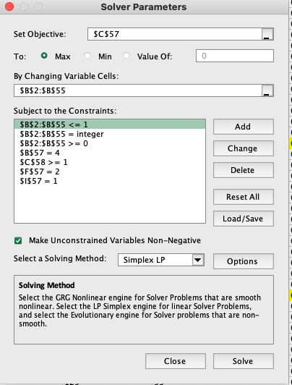
Penalty kill players dataset

Slide 15
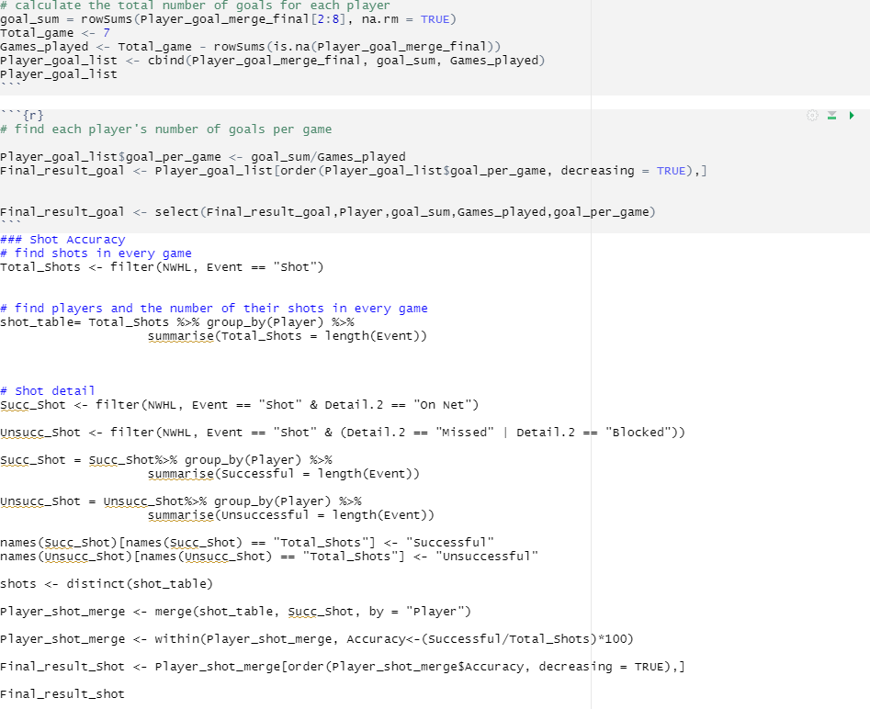
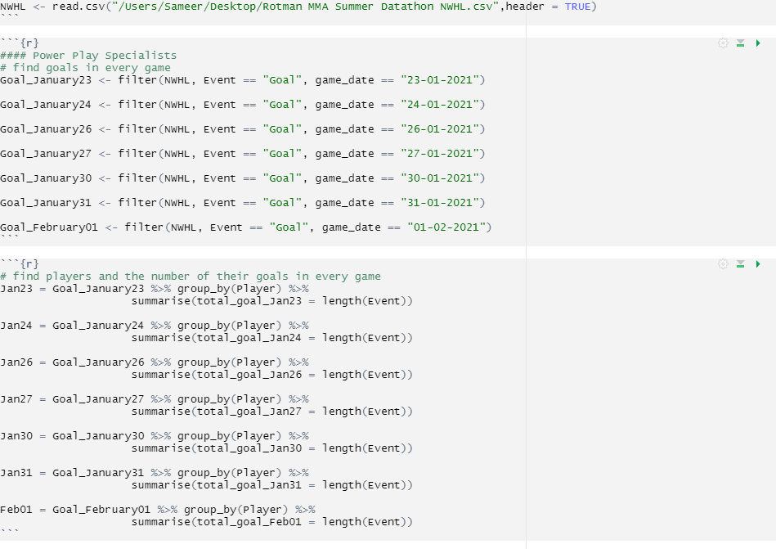
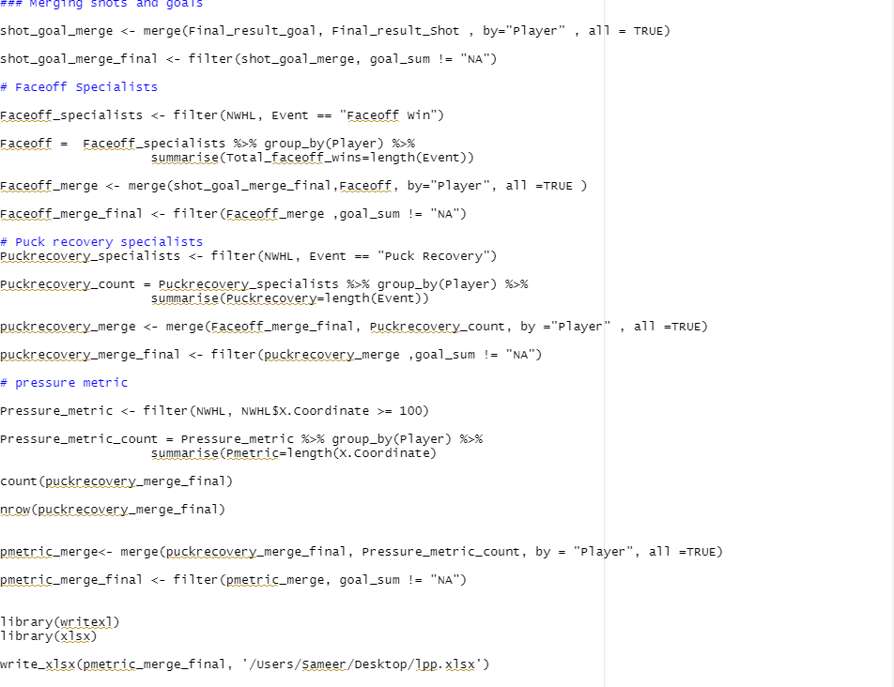
Appendix
Power Play R code:

Slide 16
